Slide 1

Computational Thermal Engineering
Saleem Raza
Jeonbuk National University Department Of Mechanical Design Engineering

Slide 2

Topic
Simulating the Optimization of Carbon Fiber Reinforced Polymers a Wrapping Structure on Piping System Using SolidWorks

Slide 3
Contents
Introduction
Methodology
Result
Conclusion
3

Slide 4
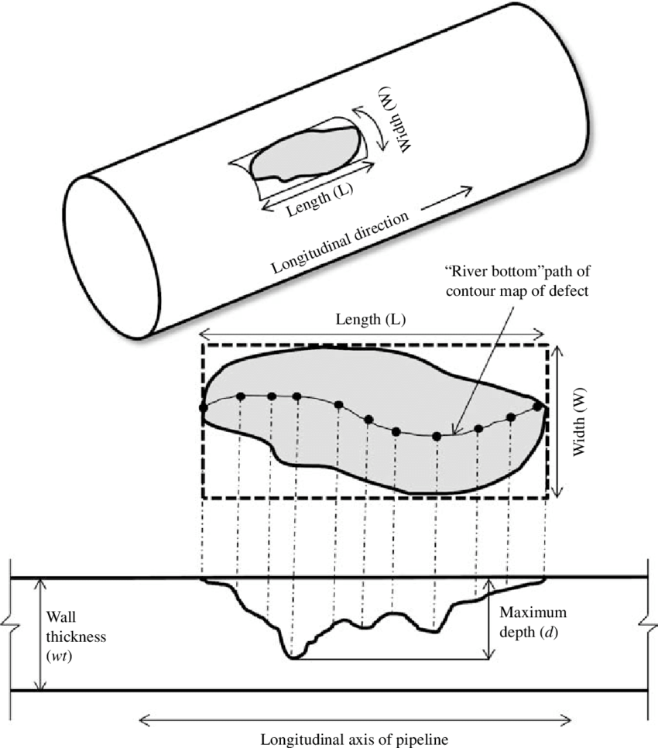
Introduction
Importance of Pipeline System specially in Oil and Gas Sectors
Cause of Pipe Failure
Solution to Pipe Failure
Composite Failure
4

Slide 5
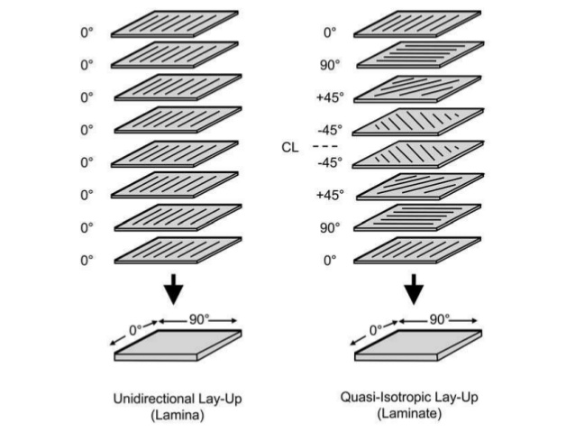
Introduction: Material Selection
Composite Fibers
Fiber Reinforced Composites (Carbon Fiber reinforced composite)
Quasi-isotropic Property of CFRP

Slide 6
Methodology
Modelling (ASME-PCC-2-2018)
Simulation
Post-Processing
6

Slide 7
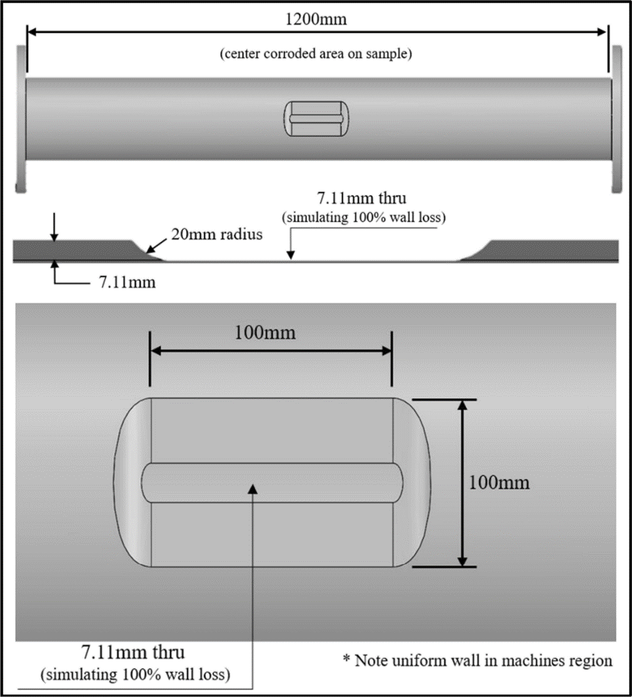
Modelling
To avoid any unavoidable incidents to occur, the parameters refer to ASME-PCC-2-2018
Outer Diameter 168.3mm
Wall thickness 7.11mm
Yield Strength 235Mpa

Slide 8
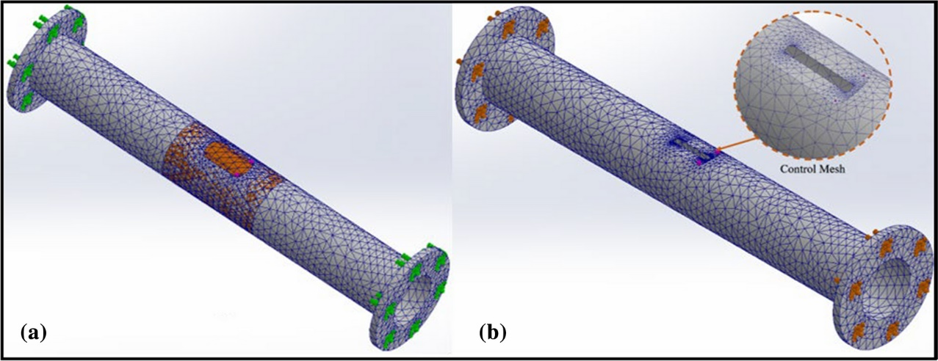
Modelling
After the Designing the next step is Meshing
A Proper meshing size was assigned to generate mesh for all parts
SolidWorks provides default meshing through proper manager and it makes the whole process easy
Although the meshing could be done but it is very necessary to have the Control Mesh

Slide 9
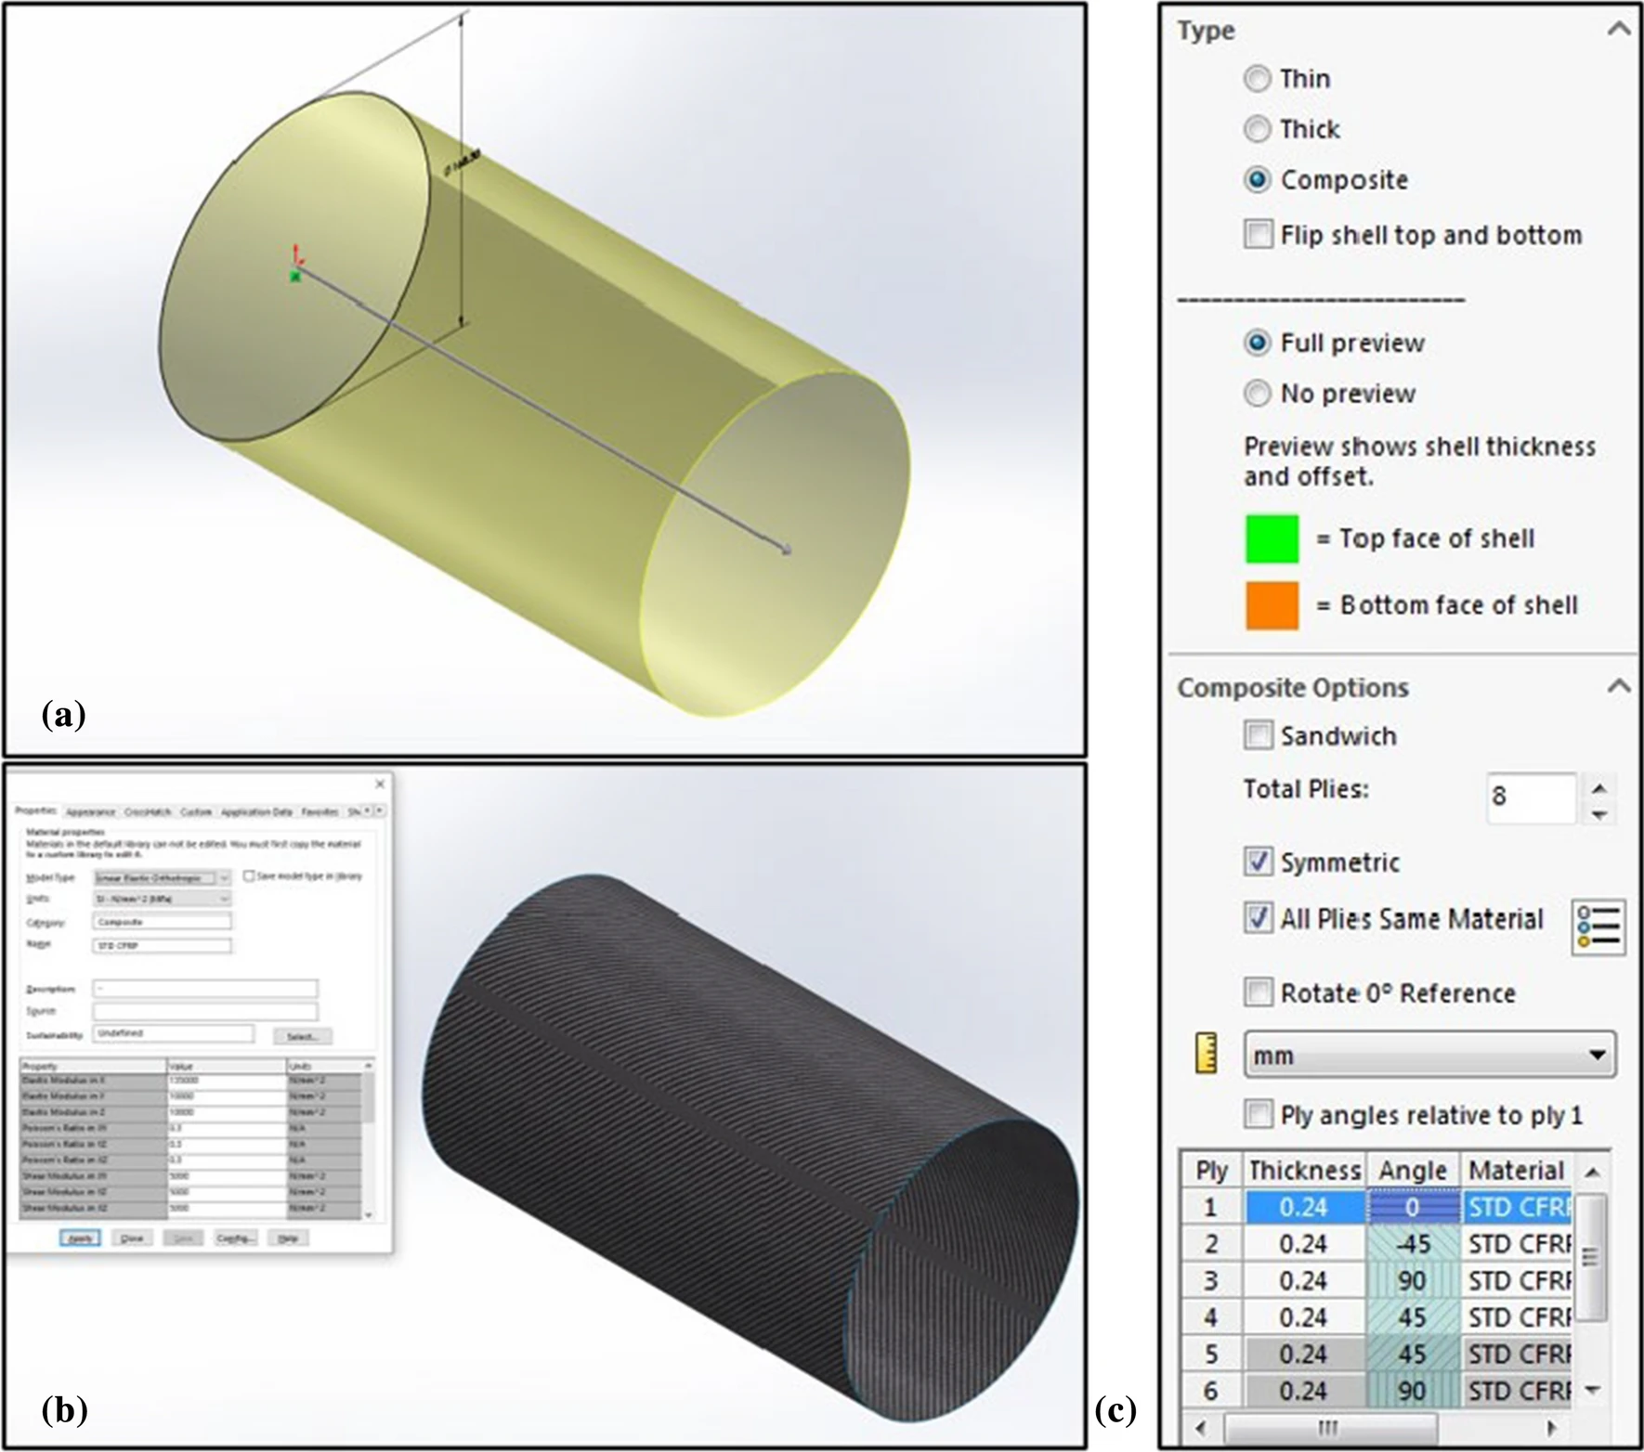
Simulations
The Static Analysis of CFRP as Wrapping Structure to ensure that the wrapper could withstand the pressure parameters that were given by the standards
Static analysis is done to verify which one is best solution for the leakages through flow simulation
And this is only possible if the geometry is water tight
The analysis was focused on the performance of the wrapper by loading various internal pressure along pipe

Slide 10
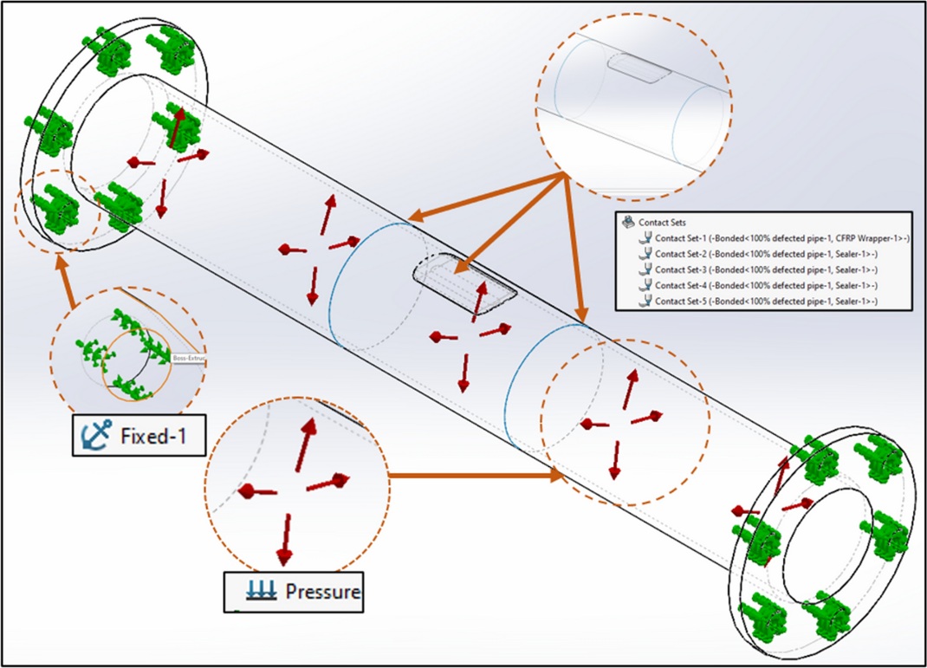
Simulations
This research use the real case data for pressure at 5.65Mpa
Maximum Temperature 343.3 C and the minimum test temperature was set at -6.67 C
The type of flow was assumed to be Steady state, laminar, no turbulence or heat transfer
The pressure boundary condition is used to impose a fully develop velocity profile

Slide 11
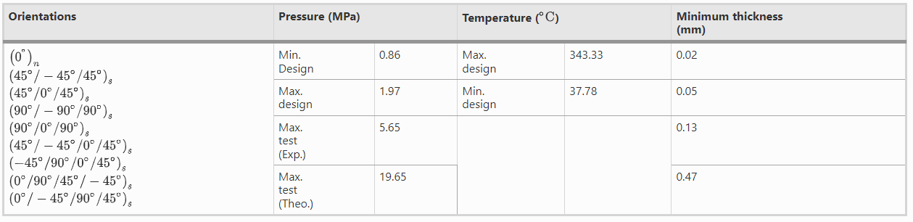
Result and Discussion
Different types of orientation was used to analyze the defected pipe as shown in the table below
GFRP wrapper was also simulated to compare the performance of both Wrappers

Slide 12
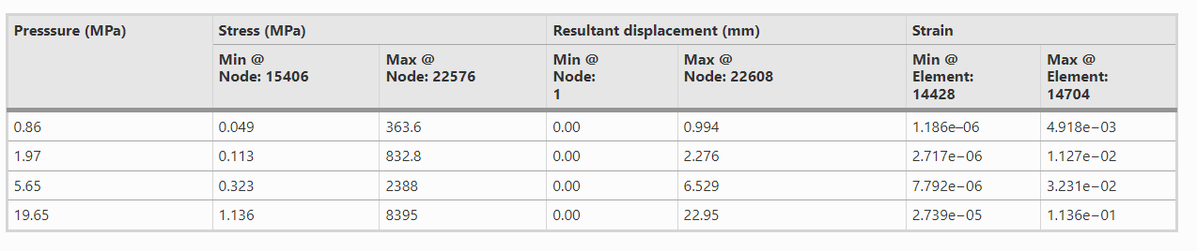
Results and Discussion
To evaluate the performance of CFRP wrapper it is important to analyze the stress, resultant displacement, and strain of unrepaired pipe the summary of static analysis of the unrepaired defected pipe is given by the table below

Slide 13
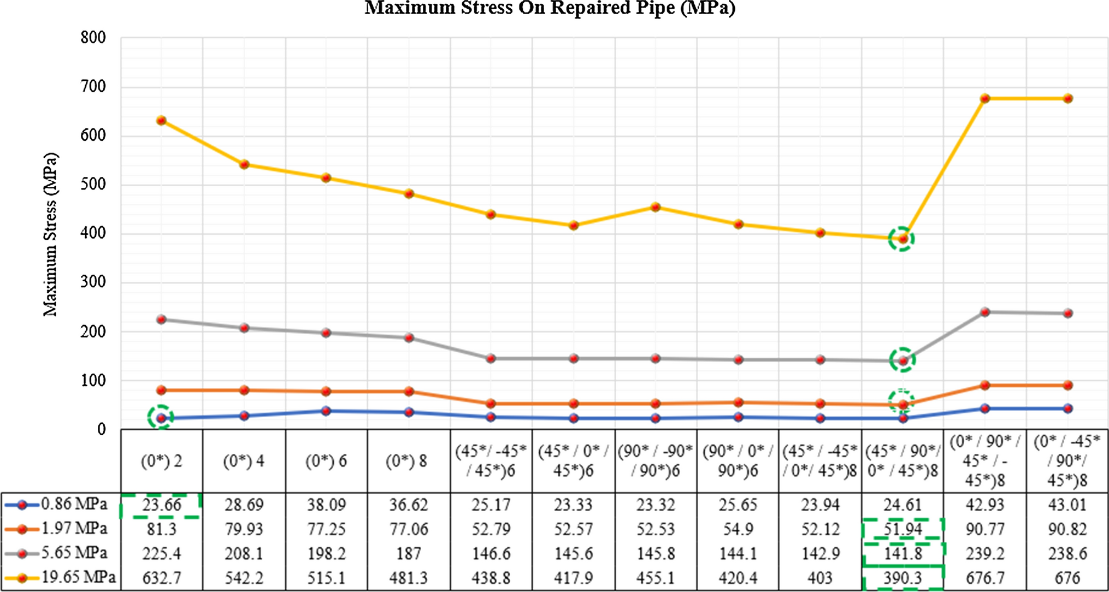
Maximum Stress On Repaired Pipe MPa

Slide 14
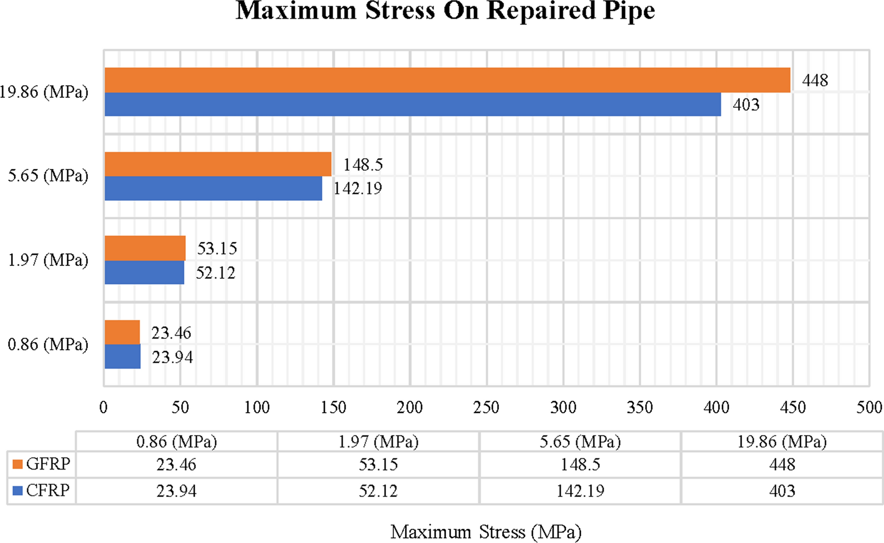
Maximum Stress On Repaired Pipe MPa

Slide 15
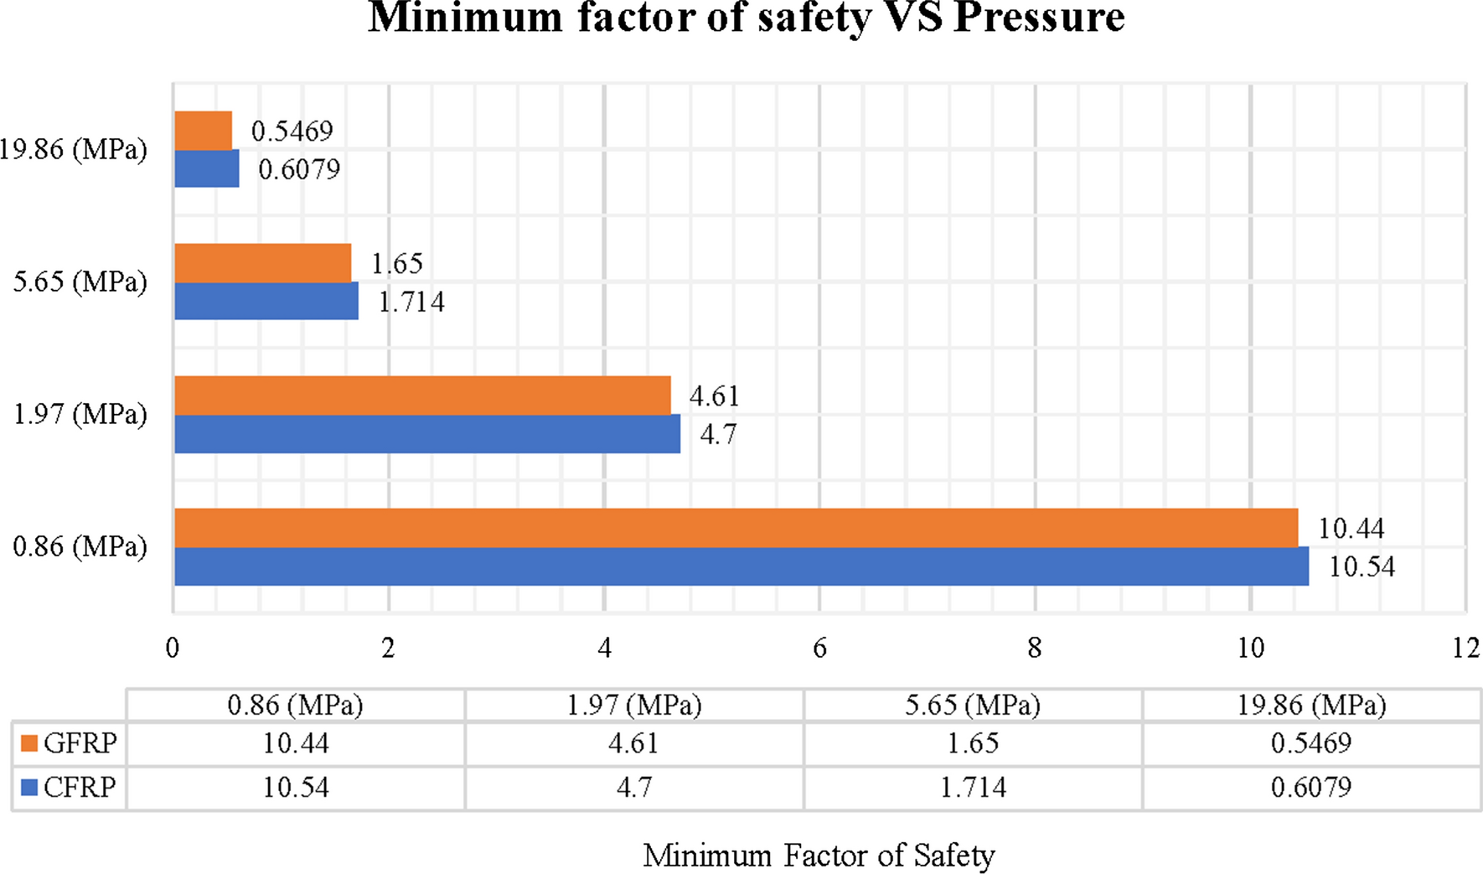
Factor of Safety VS Pressure
Semantic based
15

Slide 16
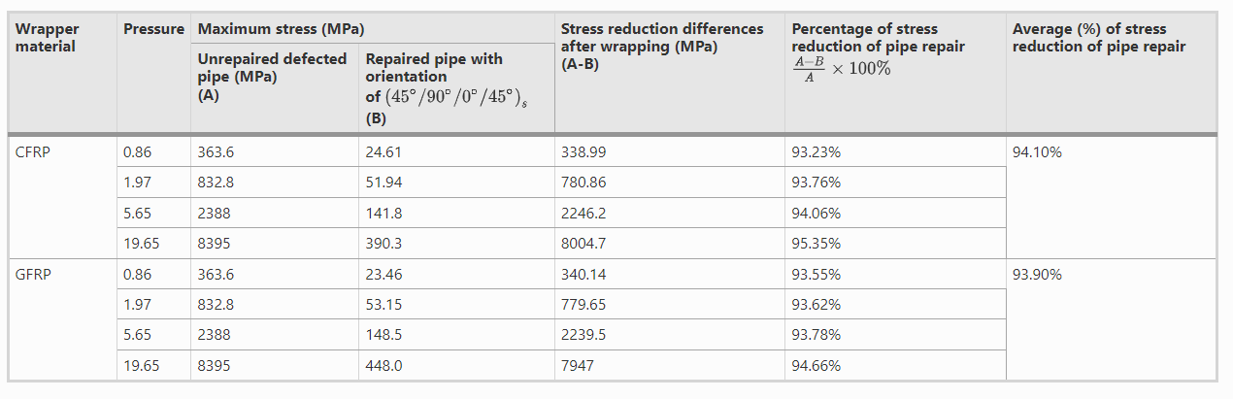
Comparison of Stress Reduction between CFRP and GFRP
16

Slide 17
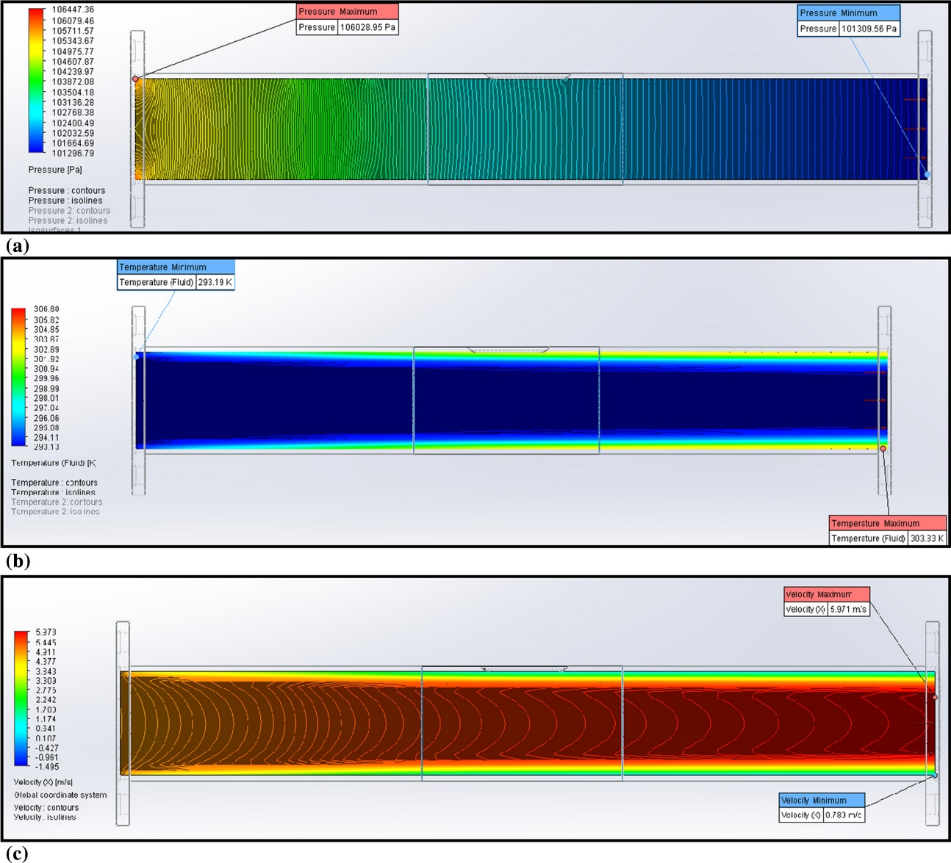
Pressure, Temperature and Velocity Contours
Pressure contours
Temperature contours
Velocity contours
17

Slide 18
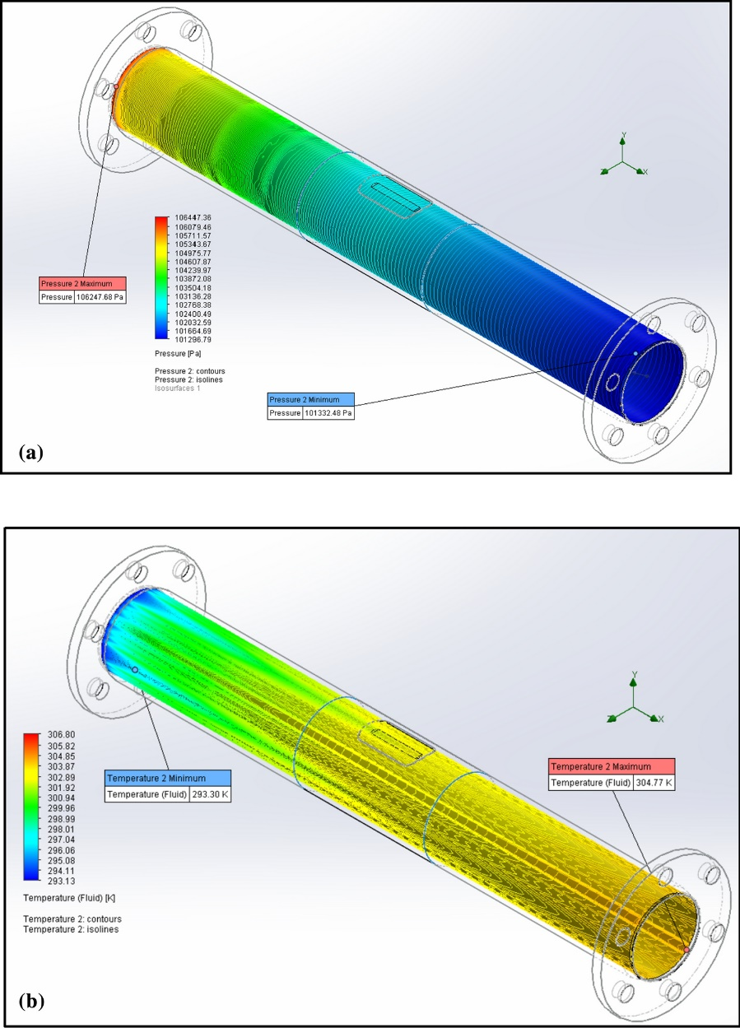
Surface Plots
Surface Plots are another type of analysis for better visual analysis
Both surface plots indicate that there were no any critical stress and thermal stress exposed by the fluid particularly at the defected region after repaired
Surface Plot for Pressure
Surface Plot for Temperature

Slide 19
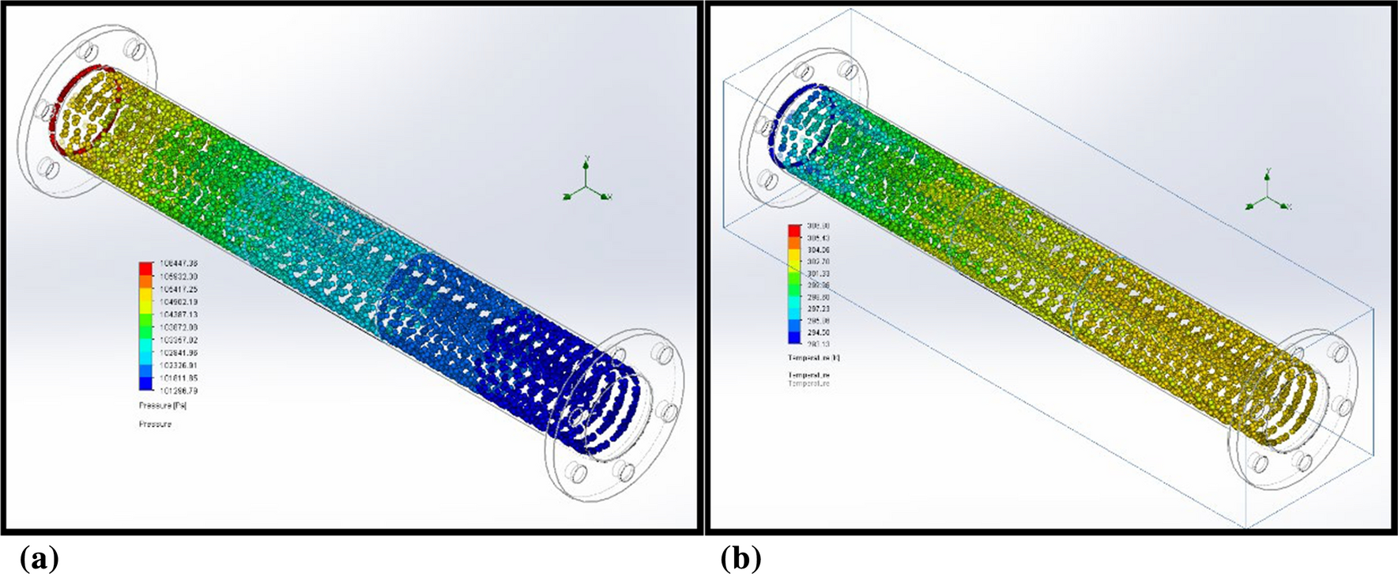
Flow Trajectory
Flow trajectories for pressure Flow trajectories for Velocity
18

Slide 20

THANK YOU
19

